Slide 1
Module 3: Intro to Docker
Jim Cheshire, Sr. Escalation Engineer – Beta

Slide 2
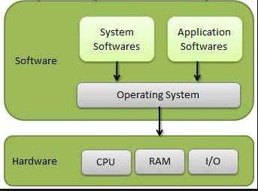
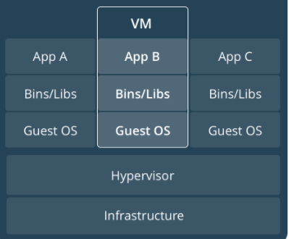
Introduction to Containers
A step back to how we used to deploy:

Slide 3
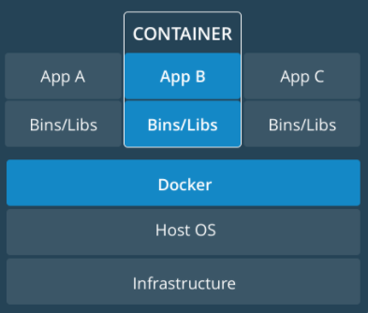
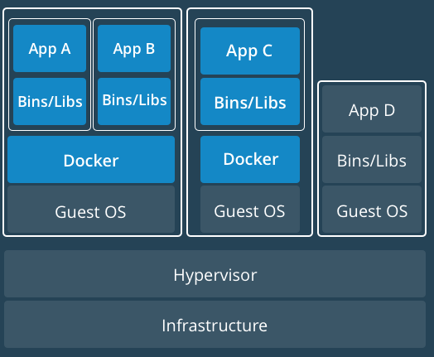
Introduction to Containers (Continued)
Deploying with Containers
Single Host VM-based

Slide 4
What is an Image?
A zipped file that contains all of the files and configuration needed to run your app.
Can be used to create a container.
On the host OS, stored in /var/lib/docker/…
Images are managed by the Docker daemon.

Slide 5
What is a Container?
An isolated environment running an app based on an image.
Has its own file system and network.
Build once and run anywhere, regardless of underlying OS. (The container runs in its own OS.)
Isolate applications from one another and underlying infrastructure.
Very secure to run.
Most popular container is Docker.
A couple of others are Rkt and Garden.

Slide 6
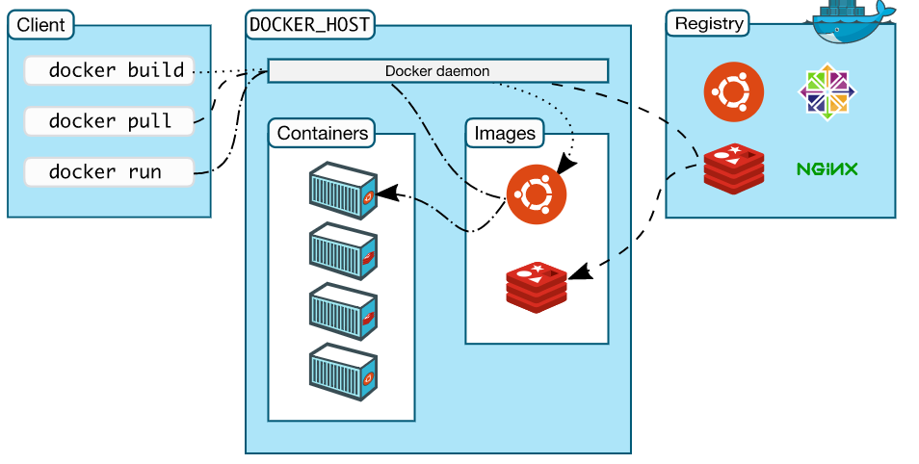
Docker
Most popular and used platform for developing, shipping and running containers
Components that enable Docker
Client (docker cli)
Docker Daemon
Containers
Images
Registry (Image repository)

Slide 7
Docker (continued)
Uses Go Language
Union File Systems
File systems that operate by creating layers, making them very fast.
Updates only require that you get the updated layers and not everything.

